Slide 1
Effect of Mineral Buildup in Closed Aquaculture Systems on Hairy Shore Crab (Hemigrapsus oregonensis)
Snodgrass, Bailey
Plinka, John Bradley
Berry, Sean

Slide 2
Background - Chemistry
Shelled invertebrates incorporate CaCO₃
Molting rate is tied to [Ca⁺] (Zanotto 2002; Perry et al. 2000); increasing [Ca⁺] sped up molt cycle (Zhang et al. 2024)
Crabs absorb the minerals and molt for homeostasis
Unknown to which degree this process “shuts down”--if at all–or cannot remove sufficient calcium
Heavy metal uptake (Cd, Hg, Pb) facilitated through calcium incorporation (Averina et al. 2022)
Heavy metals can be detrimental for organism development and human consumption through aquaculture (Martins et al. 2009)
In closed systems, this buildup is more prominent due to lack of removal methods

Slide 3
Background - Aquaculture
Aquaculture systems are important for farming shelled invertebrates
NOAA (2021) reported that global harvests in 2018 amounted to:
16.1 million tonnes of shellfish ($19 billion USD)
6.9 million tonnes of crustaceans ($36.1 billion USD)
Typical research usually centers around ocean acidification, but often do not address alkaline conditions

Slide 4
Resources
Lab Provided
Hairy Shore Crab (30-60)
Tank (2-4)
Temperature Manipulation Mechanism
Lactate and BCA Protein Physiology Assays
Independently Sourced
Calcium Carbonate Powder
Salt Water Calcium Concentration Test Kit

Slide 5
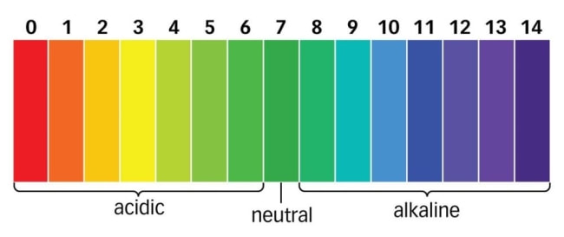
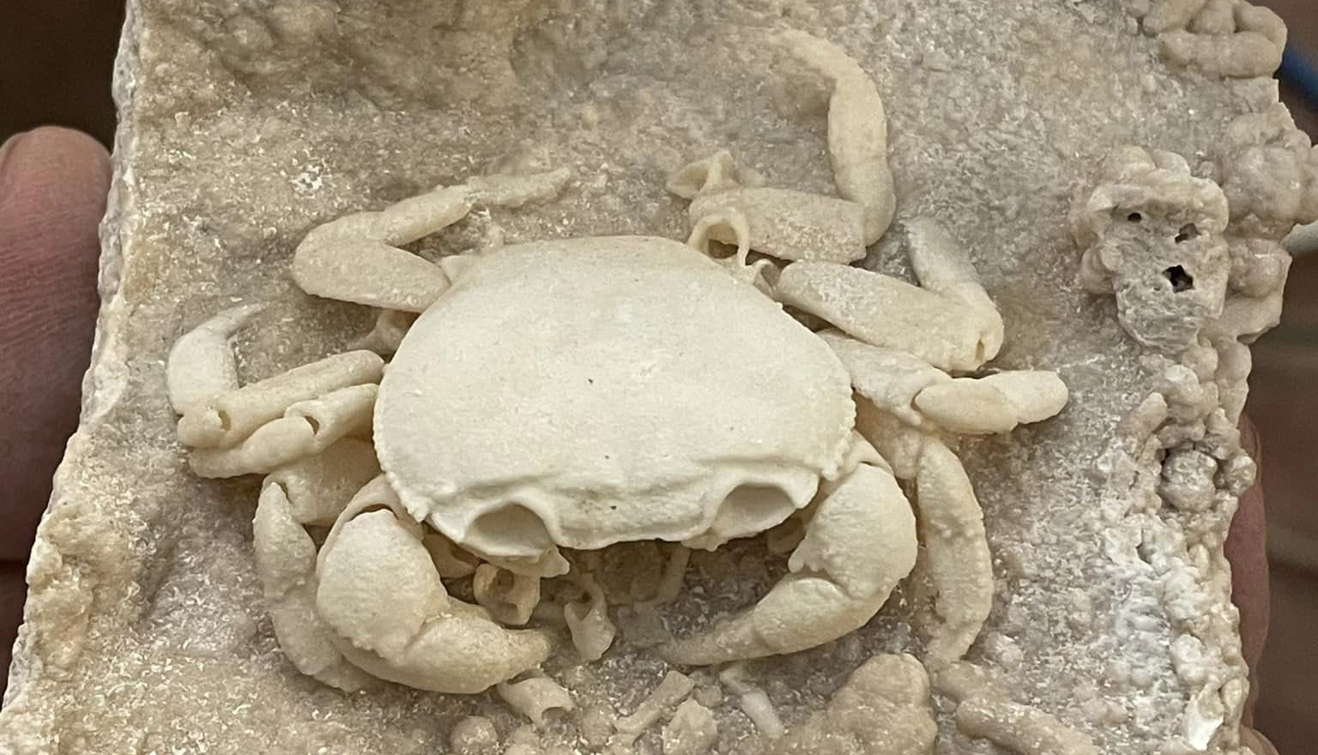
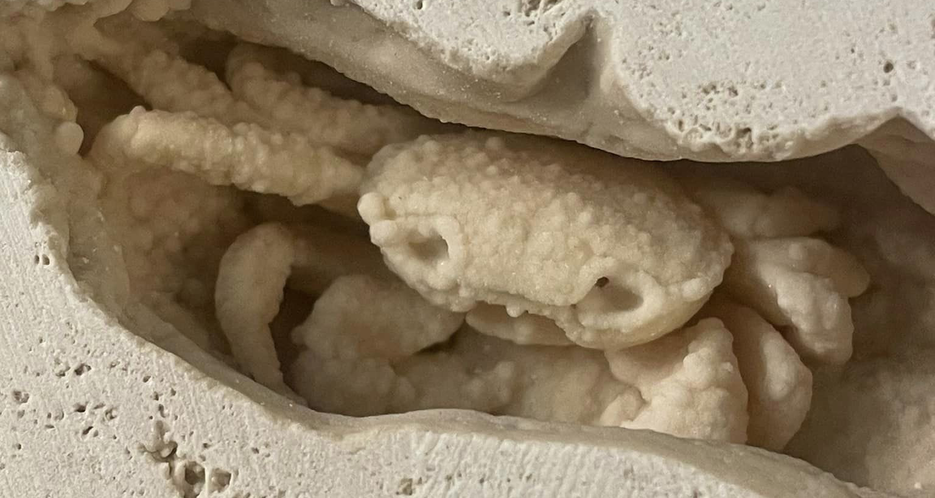
Research Question: What impact will increased dissolved calcium carbonate levels have?
Sub Question: How will increased pH/Alkalinity affect our crab’s physiology?
Sub Question: Will the dissolved calcium carbonate in the water buildup on the crab’s shells?

Slide 6
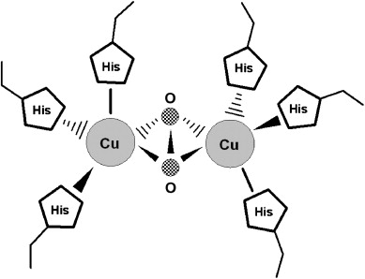
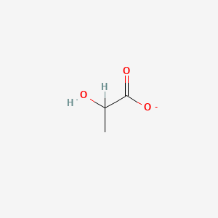

Hypotheses
Research Question 1: Alkalinity changes
Null Hypothesis: Increased pH levels from calcium carbonate will lead to no impact on the crab’s physiological functions
Alternative Hypothesis: Increased pH levels from calcium carbonate will lead to increased hemolymph lactate and decreased hemolymph protein levels.
Lactate
Hemolymph Protein (Hemocyanin: One of three main arthropod hemolymph proteins)

Slide 7
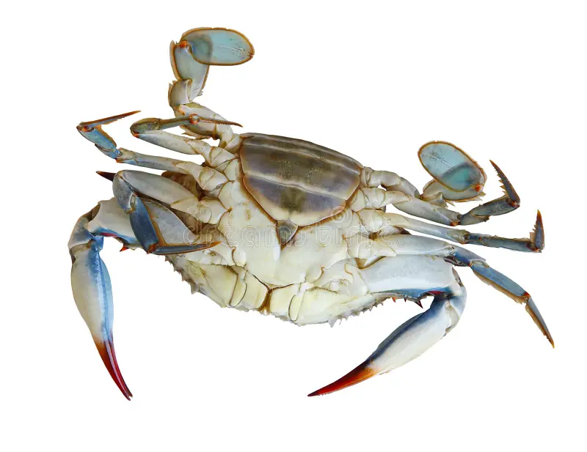
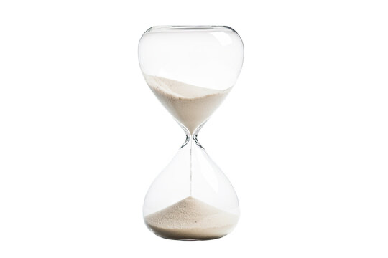
Hypotheses (Cont.)
Research Question 2: Calcification
Null Hypothesis: Increased calcium carbonate levels in the water will not affect the crab’s shells
Alternative Hypothesis: Increased calcium carbonate levels in the water will lead to calcification on the crab’s shells
Null Sub-Hypothesis: Calcification of the crab’s shells will lead to no physiological responses
Alternative Sub-Hypothesis: Calcification of the crab’s shells will cause negative physiological effects such as increased molting, increased response to heat stress, and longer righting times.

Slide 8
Experimental Design
Tank Setup
15 replicates per treatment
Sand substrate
Treatment Options
Control
Calcium Carbonate Supersaturation
Heat stress (Optional)
Heat Stress With Calcium Carbonate Hyper Saturation (Optional)

Slide 9
Experimental Design (continued)
Control
Average Temperature (7.6 °C)
Average Calcium Concentration (400 ppm)
Heat Stress
Augmented Temperature (17.6 °C)
Average Calcium Concentration (400 ppm)
Calcium Carbonate Hypersaturation
Average Temperature (7.6 °C)
Augmented Calcium Concentration (800 ppm)
Heat Stress with Calcium Carbonate Hypersaturation
Augmented Temperature (17.6 °C)
Augmented Calcium Concentration (800 ppm)

Slide 10
Experimental Design (continued)
Calcium Carbonate Application
1 mg Ca/L = 1 ppm
1mg CaCO₃ = 0.4 mg Ca
Weekly addition to maintain concentration (daily if possible)
Weekly calcium concentration test
Heat Application
Set to 17.6 °C (if digital) or apply heat lamp and take temperature reading

Slide 11
Assessment
Acute Stress (Open Systems)
Lactate Physiology Assay
Indicative of anaerobic respiration
Within 24 hours of final calcium carbonate application
Chronic Stress (Closed Systems)
BCA Protein Physiology Assay
Indicative of protein consumption
Behavior
Righting
Indicative of overall health

Slide 12
References
Averina M., Bjorke-Monsen A.L., Bolann B.J., Brox J., Eggesbo M., Hokstad I., Huber S., and Orebech P. (2022, September 5) High level of heavy metals in crab meat. Tidsskriftet. https://tidsskriftet.no/en/2022/09/perspectives/high-level-heavy-metals-crab-meat
Perry, H., Trigg, C., Larsen, K., Freeman, J., Erickson, M., & Henry, R. (2001). Calcium concentration in seawater and exoskeletal calcification in the blue crab, Callinectes sapidus. Aquaculture, 198(3), 197–208. https://doi.org/10.1016/S0044-8486(00)00603-7
NOAA (2021, June 8). Global Aquaculture. NOAA. https://www.fisheries.noaa.gov/national/aquaculture/global-aquaculture
Zanotto F.P. and Wheatly M.G. (2002) Calcium balance in crustaceans: nutritional aspects of physiological regulation. Comp Biochem and Phys, 133(2003), 645-660.
Zhang, Y., Gao, W., Yuan, Y., Cui, W., Xiang, Z., Ye, S., Ikhwanuddin, M., & Ma, H. (2024). Impact and accumulation of calcium on soft-shell mud crab Scylla paramamosain in recirculating aquaculture system. Aquaculture, 593, 741323. https://doi.org/10.1016/j.aquaculture.2024.741323

